Slide 1


ECEN 404
Bi-Weekly Update 1
Matrix 1 / “Scooter Juice”
Connor Cottongame
John Dusterhoff
Blake Hallam
Oscar Rubio
TA: Sabyasachi Gupta
Sponsor: Prof Prasad Enjeti

Slide 2

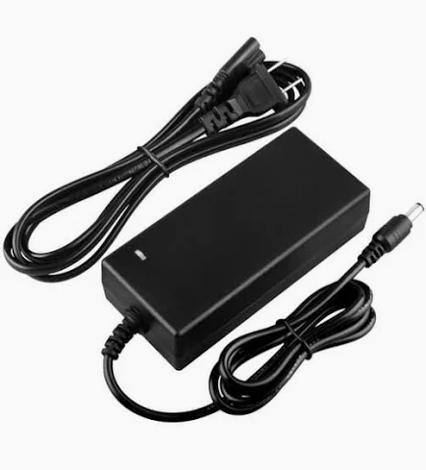

Project Summary
Problem statement:
Current electric scooter chargers are bulky and inconvenient to use, requiring large, external rectifiers to charge their batteries, much like a laptop charger.
Our Solution:
This team will design and build an IOBC (Integrated On-Board Charger), allowing the scooter to be charged directly from an AC power source.
This charger will use the existing inverter components in the scooter as a rectifier in order to charge the battery.

Slide 3
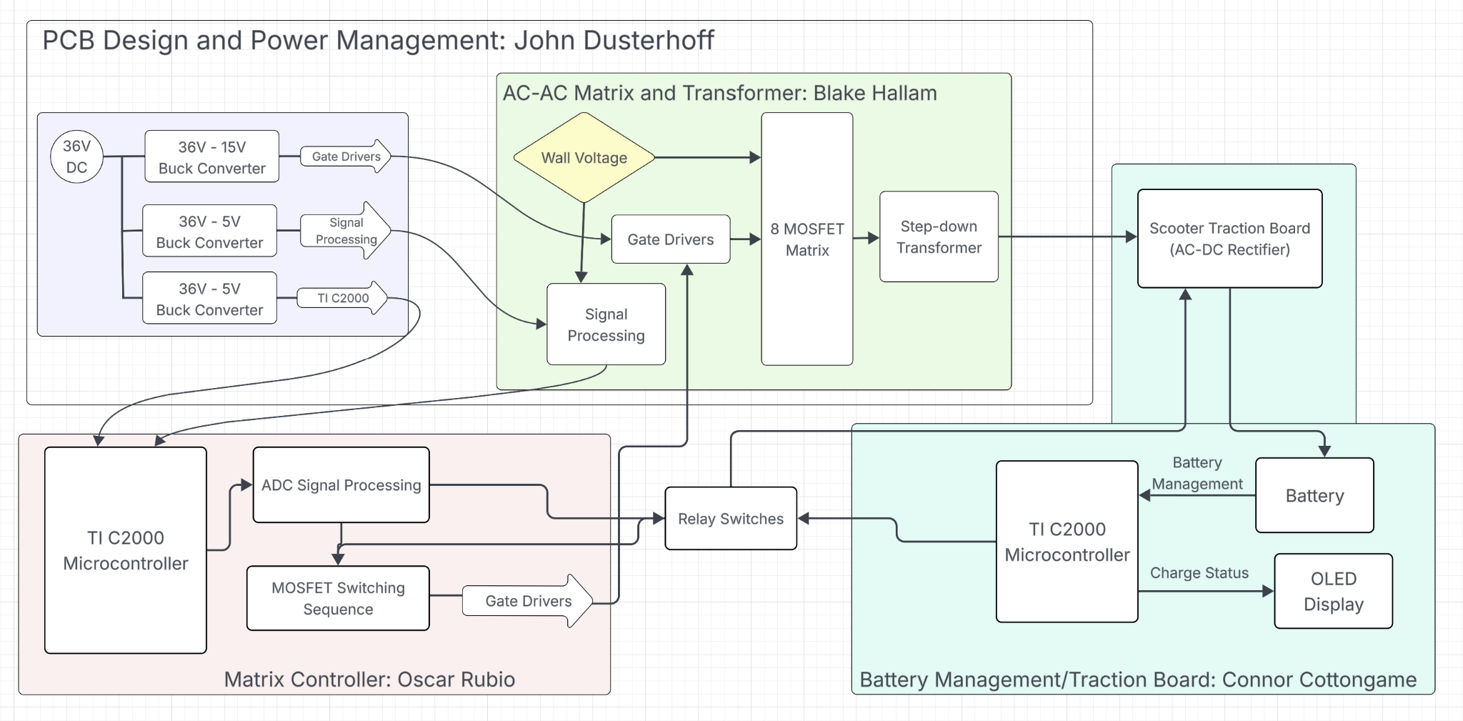
System Overview
Notes:
Cloud server and database

Slide 4
Major Project Changes for 404
Major project changes may occur after sit down meeting with project sponsor and TA
PCB formatting and modularity are subject to change based on meeting with sponsor and TA

Slide 5
Project Timeline
Subsystem Designs and Updated and necessary testing (completed by 9/14) | Final subsystem testing and start integration (completed by 9/28) | Integration of MCU, signal processing and power stages (complete by 10/1) | Final Integration (to complete by 10/22) | System Test (to complete by 11/5) | Validation (to complete by 11/12) | Demo and Report (to complete by 12/5)

Slide 6
Signals & Power Conditioning
Blake Hallam
Accomplishments since midterm update 6 hours of effort | Ongoing progress/problems and plans until the next presentation
Confirmed the need of new components to increase efficiency of circuit. Confirmed new PCB design for subsystem. | Further testing resistor divider for the isolation amplifier and adding a DC bias voltage to the input. Further Diagnosing the RLC circuit used to condition the input to the transformer.

Slide 7
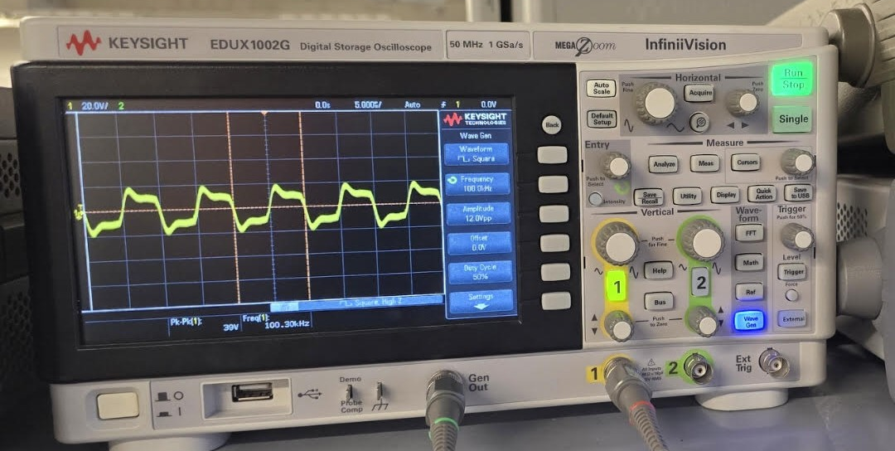
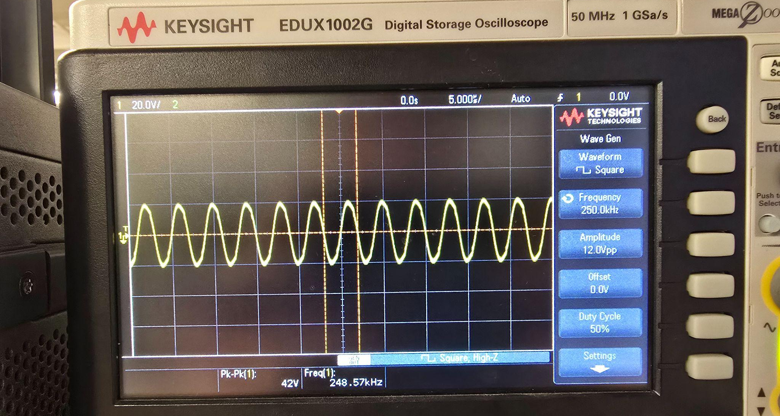
Signals & Power Conditioning
Blake Hallam

Slide 8
Matrix Control Subsystem
Oscar Rubio
Accomplishments since midterm update 8 hrs of effort | Ongoing progress/problems and plans until the next presentation
Retested completed portion of matrix control to verify proper functionality | Building the ADC program to obtain polarity and edge switching inputs Test ADC to ensure it can read AC signal from 0-2V and produce input bits used by CLB

Slide 9
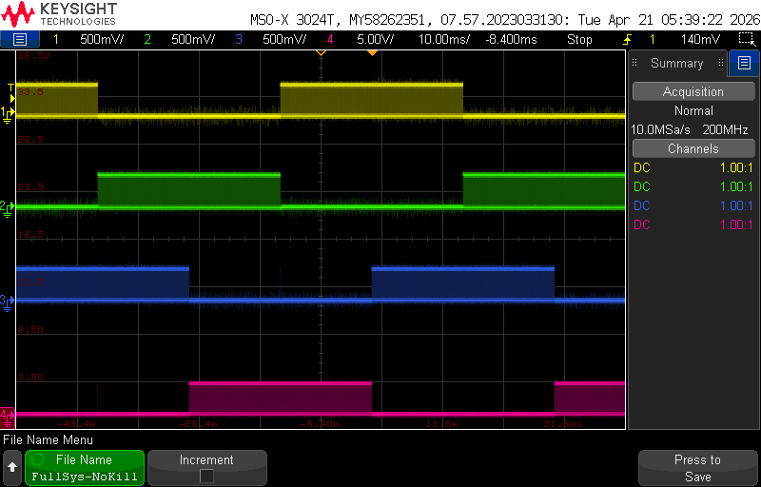
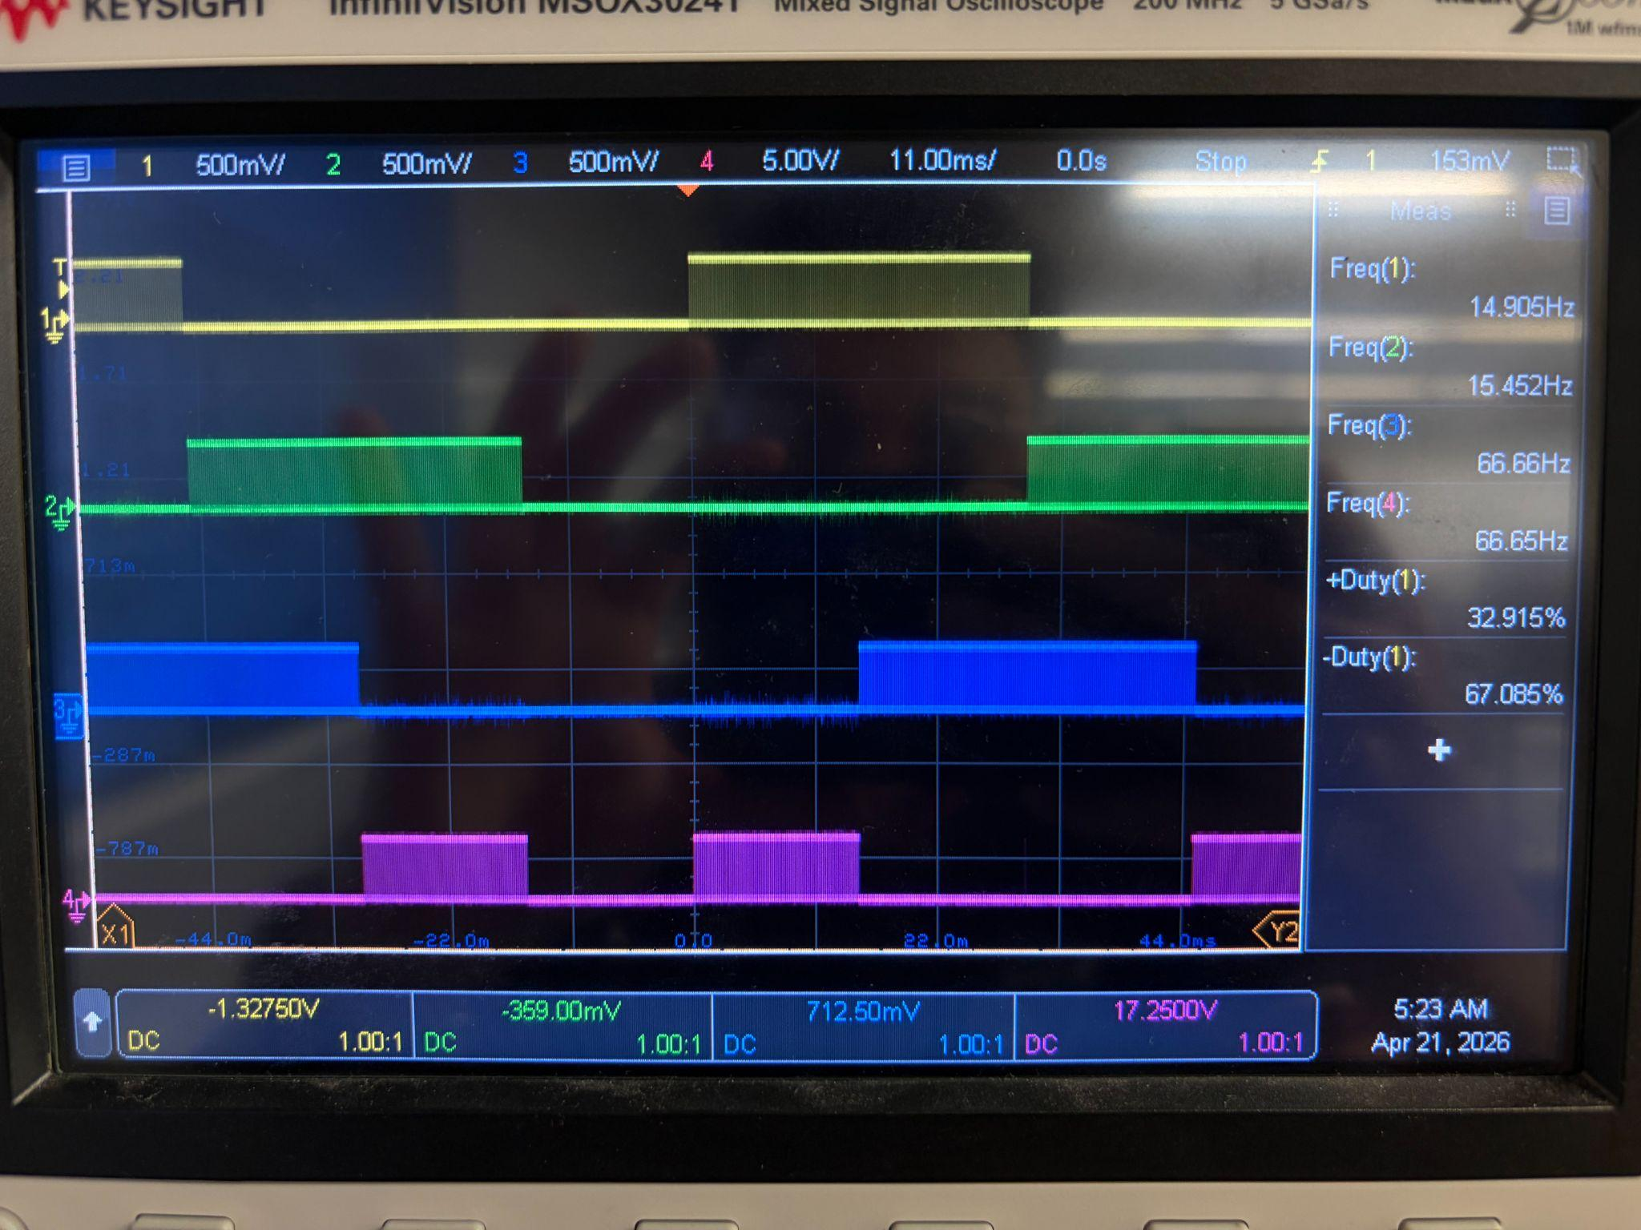
Matrix Control Subsystem
Oscar Rubio
Full System with no Kill System Activated
Full System with Kill System Activated

Slide 10
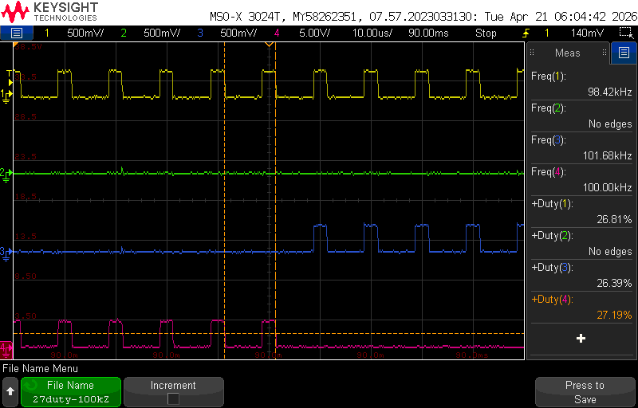
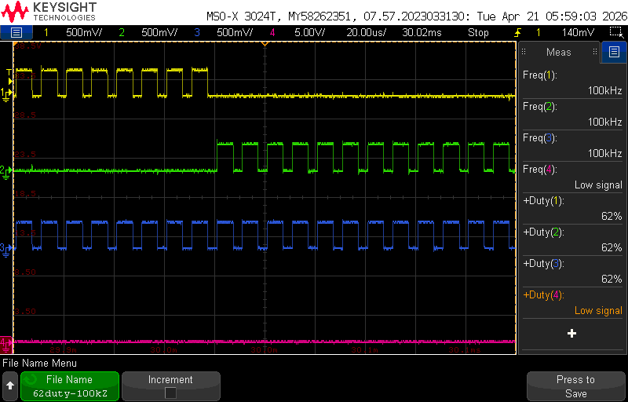
Matrix Control Subsystem
Oscar Rubio
Full system functioning with different duty cycle values
Full functioning system with proper gate switch timing

Slide 11
PCB Design
John Dusterhoff
Accomplishments since midterm update 8 hrs of effort | Ongoing progress/problems and plans until the next presentation
Design documents reviewed and updates for the next few weeks planned in order to make a more functional prototype System still works for 403, improvements can be made to size, functionality, and subsystem integration | Get the PCB updated to reflect things learned in testing last semester Fully implement new features and design updates, including proper UI support Shrink the size of the PCB board as well as make components more densely packed to create a more robust design.

Slide 12
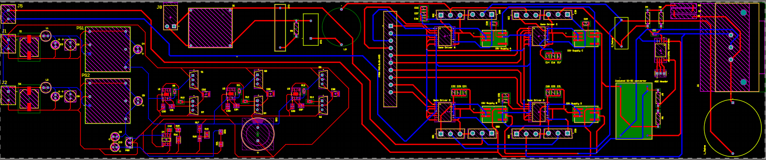
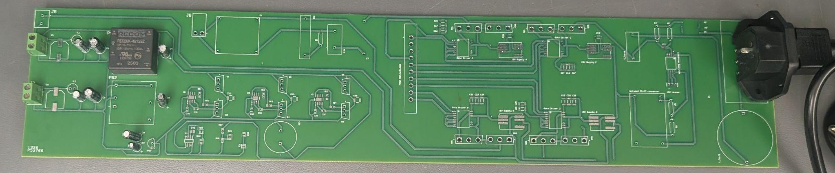
PCB Design
John Dusterhoff
Interesting figures related to your subsystem progress
Detail on what designed, built, tested

Slide 13
Charging Control Software
Connor Cottongame
Accomplishments in 403 5 hrs of effort | Ongoing progress/problems and plans until the next presentation
CC/CV charging firmware + DAB TPS control on TI C2000 Full charge cycle validated in simulation on MCU Live web telemetry dashboard | Designing new and improved secondary-side (traction inverter) PCB

Slide 14
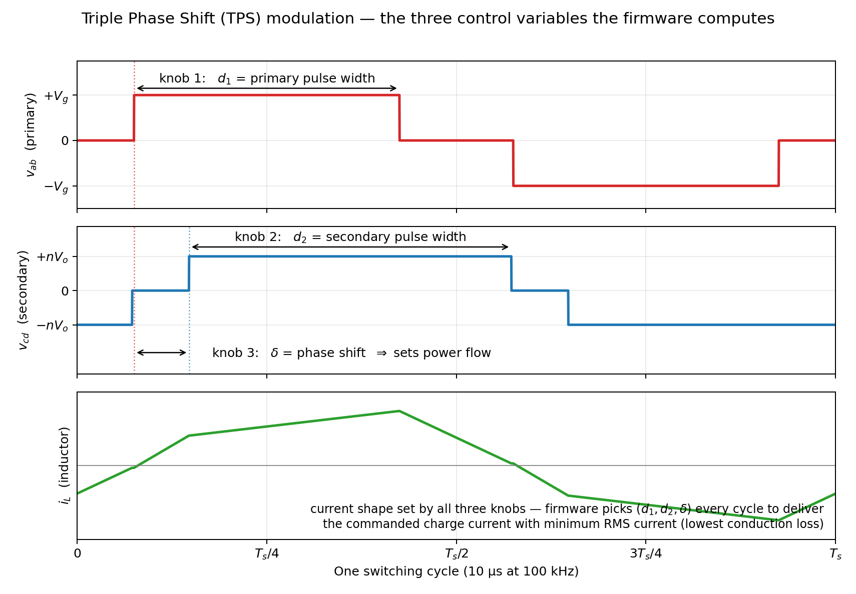
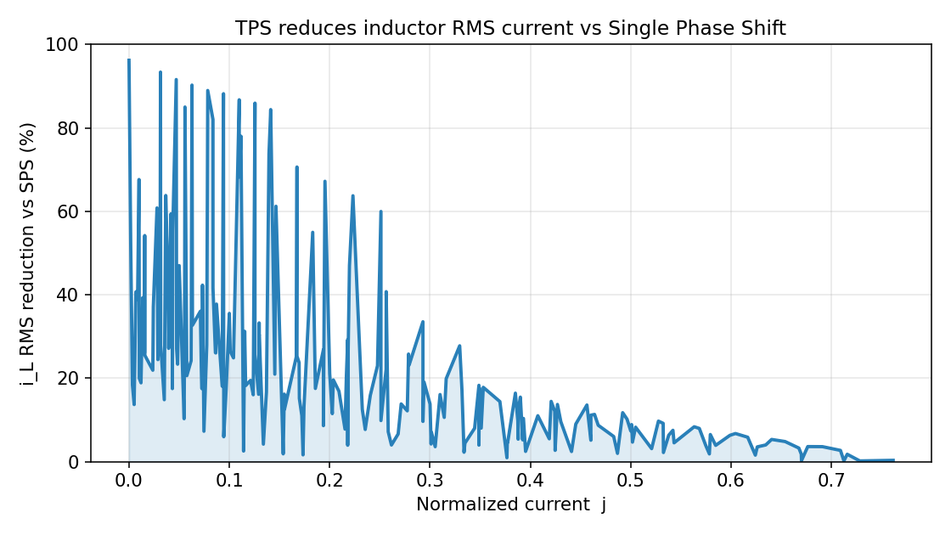
Charging Control Software
Connor Cottongame

Slide 15
Parts Ordering Status
  TI C2000 F28P65x controlCard remains to be ordered
    Expected to be here by September 10th at the latest
  Version 2 of final PCB remains to be ordered
    Expected to be ordered by September 14th at the latest after final revisions are made

Slide 16
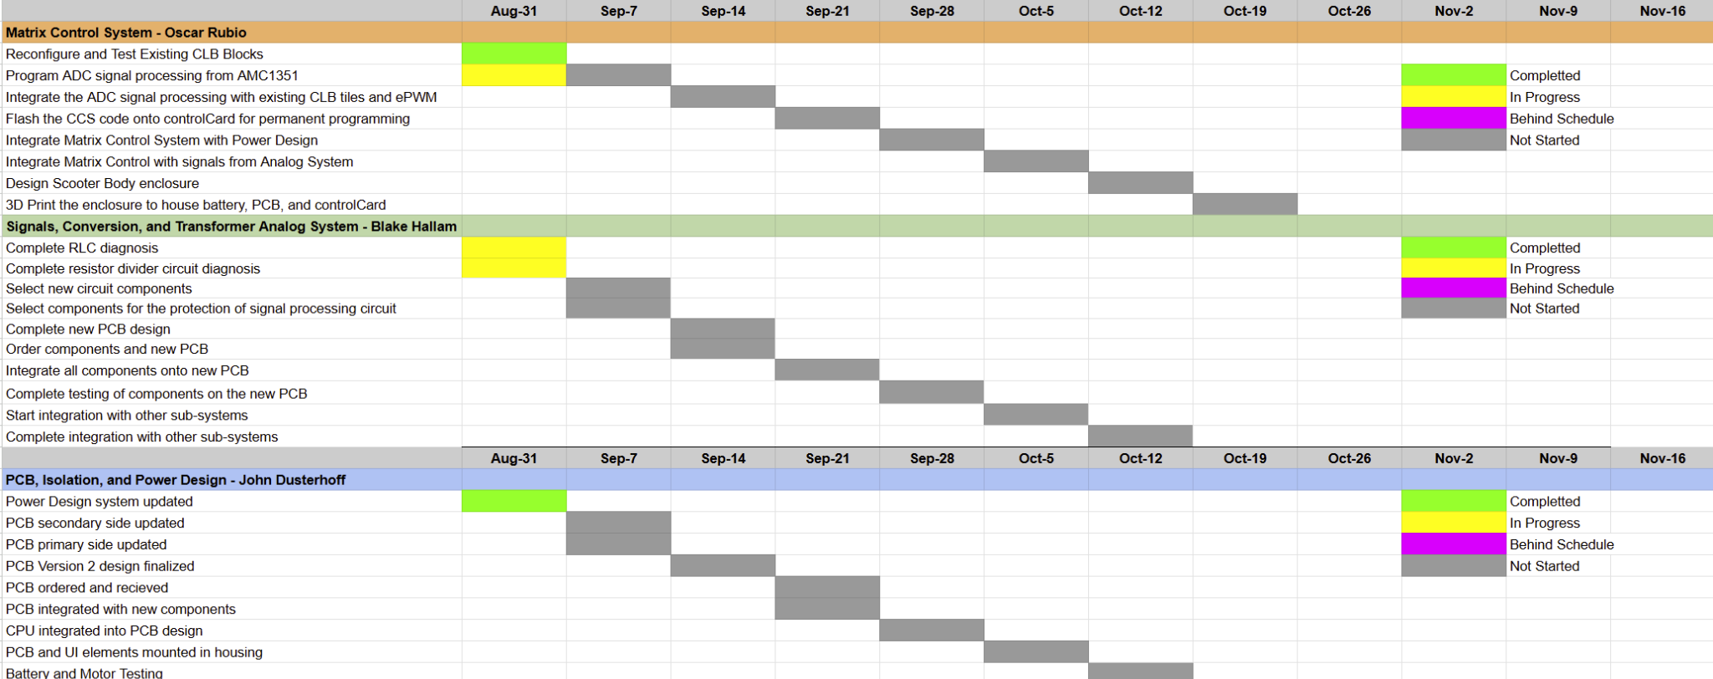
Execution Plan

Slide 17
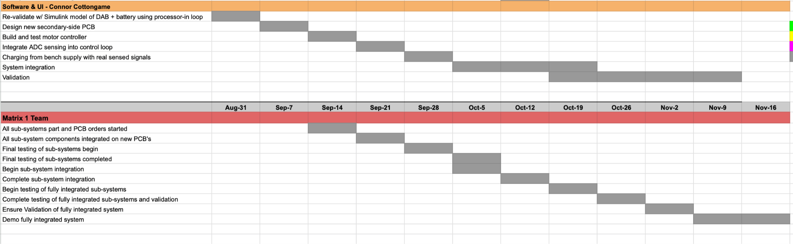
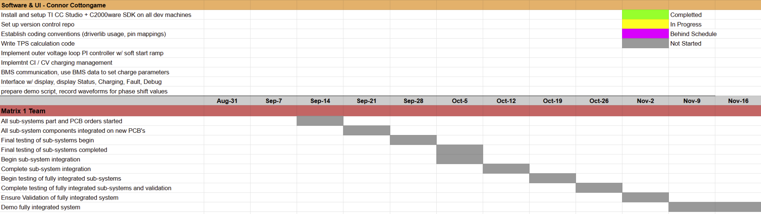
Execution Plan

Slide 18
Thank You For Your Time and Attention
Any Questions?
Matrix 1 / “Scooter Juice”
Connor Cottongame
John Dusterhoff
Blake Hallam
Oscar Rubio
TA: Sabyasachi Gupta
Sponsor: Prof Prasad Enjeti

